Slide 1
Advising
Technical - Overview
Integration Team
July 2017

Slide 2
AGENDA
Overview
Structure Types
Flows
Interfaces Type
Samples

Slide 3
“
During the various stages of payment processing, the Notification and Advice Determination and Generation-related services are invoked as part of the flow management. ”

Slide 4
Advising Interface
Available at every complete or intermediate status
Advising System
Account Lookup
Internet Banking, Branch-OTC, SWIFT, Local Clearing
Receive Payment Instruction
Payment Initiation
Debit Side Processing
Credit Side Processing
Notification/advice-related services and activities include:
Selecting advice types that are candidates for generation using the Advising type selection rule
Determining whether advices are required for the debit account/party, credit account/party, and fee account
Generating, sending and registering interface advices
Compliance
FX Engine
SWIFT, Local Clearing
Payment execution
Fees Processing
MOP Selection Value Date and Cut Offs
Accounting System
Balance Inquiry

Slide 5


Advising selection Rule
In order to trigger Advising, an advising selection rule needs to be set-up.
Rule
The action of rule 172 set the advising Type and structure.
For example: Acknowledgment for Pain.001 will be “pure” Pain.002, without
FNDT message.
Advice can be FULL FNDT message according to the interface type

Slide 6
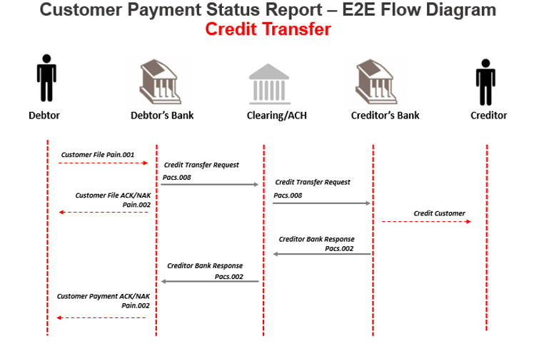
FndtMsg XML Sections
GPP generates the following types of acknowledgments (both in pain.002 format):
ACK: A positive acknowledgment message
NAK: A negative acknowledgment message

Slide 7
Pain.002 interfaces
Pain.002 Acknowledgment Level
Acknowledgment Level | Discerption
File level | GPP Generates a file level ACK/NAK to indicate whether the file was accepted or rejected before pre-processing
Transaction level - Store | GPP stores the Pain.002 request for each processed transaction to be later used by the EOB (End Of Batch) report
End Of Batch | GPP generates an EOB report to the customer about the status of transactions within a file received.
Transaction level | GPP generates a transaction level ACK/NAK to indicate the customer about a change of a transaction status after the pre-processing

Slide 8

File level
To indicate the customer about file rejects or file which succeeded processing.
GPP Can create ‘File Level ACK/NAC’ in case the file is rejected or in case the file has succeeded, based on business setup configuration.
GPP receives a file from the initiating party and starts processing the file, once the pre-processing stage is completed GPP can be setup to call an interface in order to send a file level notification.
pain.001
pain.002 (ACK/NAC)

Slide 9
End of batch
To give a report to the customer about the status of transactions within a file received from the customer.
GPP receives a file from the initiating party and starts processing the file and each transaction within it during the pre-processing phase.
Once pre-processing is complete and GPP had stored the transaction information with transaction status in the DB, GPP calls an interface to send an End Of Batch transaction level notification.
pain.001
pain.002
with transaction final status

Slide 10
Thank you
Alex Perman
Integration Team
alexander.perman@finastra.com

